Slide 1
Start, Grow, Revive Your Business
Workshop Series
Session #1
Notes:
Brief enthusiastic welcome!

Slide 2
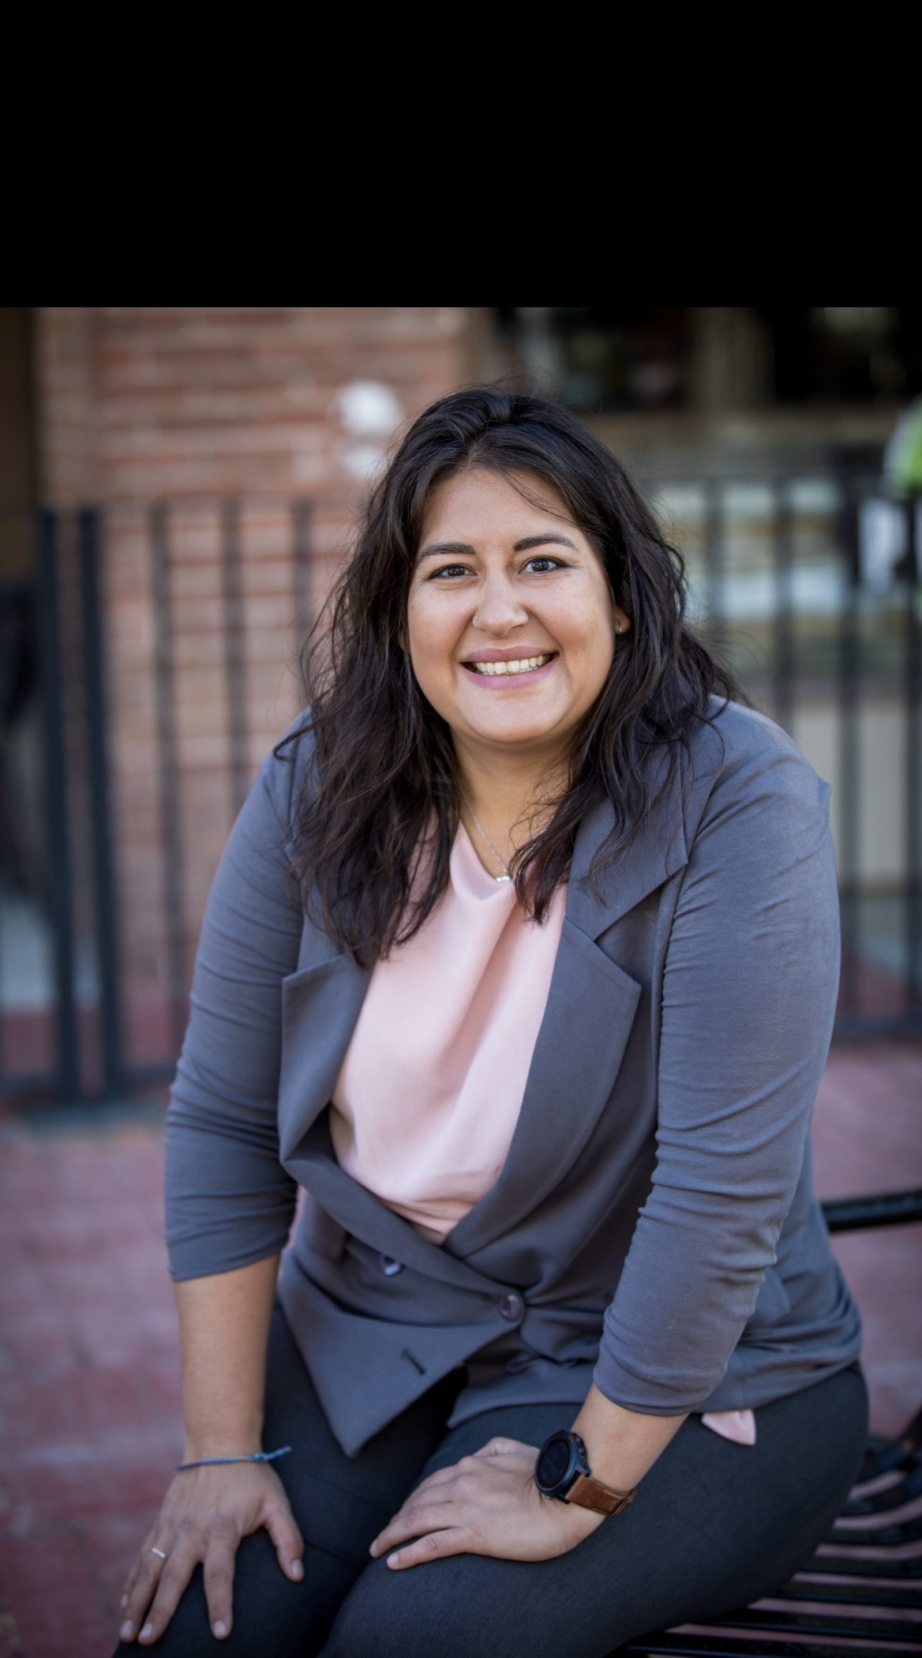
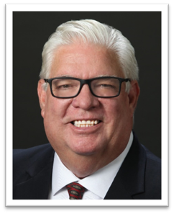
Your Facilitators:
Krista Gaona-Cortez
RCAC
986.207.8785
krista.cortez@rcac.org
Dan Dever
RCAC
602.818.9409
dan.dever@rcac.org
© 2019, Rural Community Assistance Corporation. All rights reserved.
Notes:
Facilitators self introduction and offer a brief small business and or small business coaching background.

Slide 3



Sponsor & Community Partner
Notes:
City of Globe – MBDA

Slide 4

Workshop Dates
Workshop #1
Wednesday August 20, 2025 9am
Business Planning
Workshop #2
Wednesday September 17, 2025 9am
Marketing on a Budget
Workshop #3
Wednesday October 15, 2025 9am
Financials/Budgeting/Taxes
Workshop #4
Wednesday November 5, 2025 9am Financing
Notes:
We will be doing early registration for the participants for the future workshops today.

Slide 5
Workshop Expectations
Build a safe environment
Show respect
Be “All In” - you get out what you put in
Treat every business idea as the next great success, even if all you see are great big flaws
Meet your fellow entrepreneurs
Parking Lot
Others?
Notes:
Get agreement – ask if anything should be added – deleted. Explain how as facilitators it is our responsibility to keep the workshop on time and on task. Housekeeping as well – location of restrooms – soda machines? etc Explain the Parking Lot

Slide 6
Let’s Get to Know Each Other
This is my friend (name)
(Name) favorite non-work thing to do is…?
(Name) has lived in (hometown) since and moved here because…?
(Name) favorite thing about (hometown) is…?
Notes:
Break the ice early – get the participants to pair up and introduce each other using the above template.

Slide 7
SGR Workshop - Roadmap
Strengths & Challenges
Building & Growing $$$
Your Journey
Needs = Opportunities
Getting to Know Your Customers
Getting to Know Your Partners
Business Structure
: Business Management
“A goal without a plan is just a wish.” – Antoine de Saint-Exupery
Notes:
The SGR Workshop Roadmap provides an overview of the concepts and tools we’ll cover as part of the workshop series. We’ll check-in on the Roadmap during each session so we can see where we are, how far we’ve come and what’s coming up next.

Slide 8
Workshop Goals and Takeaways
Entrepreneur Guidance
Establish the entrepreneur mindset
Identify and pursue viable business opportunities
Understand business concepts and skills
Take business concepts and turn into actions
Identify Markets
Build individual capacity to finance business
Notes:
We can give them the tools and help them navigate. However, this is their business idea, and they are the only ones who can make it happen.

Slide 9

Most Important
Create peer-to-peer learning opportunities
Develop a peer support network
Identify helpful resources
Notes:
Stress that this is an interactive workshop series. We will be learning from each others' experiences and building on all these concepts as a group. Use each other and share resources and ideas.

Slide 10

The Paperwork
Notes:
Do MBDA paperwork – make sure everyone has signed the reg sheet

Slide 11
What do successful small businesses have in common?
A strong business plan
Their product or service solves a problem
They account for their cash needs
Have a great team
Pricing reflects the value to the customer
Understand Marketing – delivering the right message to the right customer at the right time
Notes:
Handout Common Reason Business Fail

Slide 12
Agenda
Business Planning: Why and How?
Building Your Story
Resources
Next Actions

Slide 13

Why Are You Here Today?
Your business idea or business.
Why did you make the decision to invest your time in this workshop?

Slide 14

Critical Business Skills

Slide 15
"Listen to feedback, be open to change, leverage your strengths, accept your limitations, be persistent and never lose sight of your vision."—Saskia Sorrosa, founder of Fresh Bellies
“Surround yourself with people who are smarter than you are in different areas and learn from them. There's no need to ever pretend like you know it all.“
- Emily Weiss, founder of Glossier

Slide 16
Critical Business Skills
Producing the product or service
Finding the buyers or customers
Managing the money
Managing overall strategic operations

Slide 17
Myth of the Perfect Entrepreneur
Most entrepreneurs are not equally good in all four areas
Success is limited by the weakest leg
Solution: Build a team

Slide 18
Personal Reflection
Critical Business Skills
Producing the product/service
Finding the buyers/customers
Managing the money
Managing overall strategic operations
Which role(s) are you good at?
Which role(s) do you like?
How will you fill the roles you are not so good at, or do not like doing?
Notes:
Small group breakout

Slide 19


Slide 20
The Business Plan
Why write a business plan?
Explains your products or services clearly
Show how you’ll make money
Assess your supply chain reliability
Identify factors that could affect demand
Guide your business decision making
Acquire funds
Notes:
We will not be writing a business plan – but we will be discussing and learning about key elements of a business plan and setting you up for success in writing one. AND hopefully mot=ivating you to write one!

Slide 21

The Business Plan: Roadmap – Compass or Both
The roadmap provides the specific path, while the compass ensures you are heading in the right direction.
why should you write a business plan video - Google Search
Notes:
A business plan should not be chiseled in stone. It is a living document that should be reviewed on a regular basis and adjusted when needed. (Give examples of changing business plans)

Slide 22
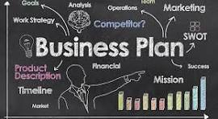
The Business Plan
Key Components
Executive Summary
Company Description
Market Analysis
Marketing Plan
Sales Plan
Competitive Analysis
Organizational Structure
Products & Services
Operating Plan
Financial Plan
Funding Sources
SWOT Analysis
Business Documentation
Professional Partnerships
Appendix

Slide 23
Business Plan Writing Resources
LivePlan
Business Plan Software With Performance Tracking | LivePlan
Initiate Platform
Initiate 3.0

Slide 24
Problem, Solution, Connection Canvas
Notes:
The Opportunity Discovery Canvas (a.k.a. The Canvas) is a tool designed to help the E to think critically about what problem he/she is trying to solve with their business idea.
The Canvas is divided into 3 sections to guide the process:
Section 1: What is the problem to solve?
Section 2: What are the possible solutions?
Section 3: How will the E connect with customers/buyers who have the problem?
Throughout the workshop series, participants will consider the three section of The Canvas individually; beginning with The Problem.

Slide 25
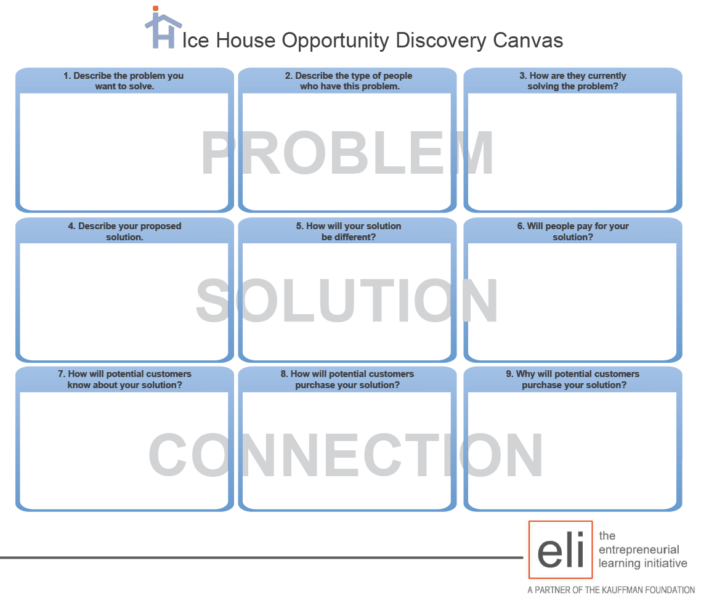
Notes:
Often when we start a business we start with the solution in mind. Today we are going to help you reframe your business as a solution to your customers problem.
The Canvas is divided into 3 sections to guide the process:
Section 1: What is the problem to solve?
Section 2: What are the possible solutions? And why is yours different
Section 3: How will the E connect with customers/buyers who have the problem?
You understand the problem. You have a great solution. Now you need customers to buy your solution. The next section of the Canvas explores how you are going to market your solution. Market Push and Pull – just because you have a solution, doesn’t mean the market wants that solution.

Slide 26
The Ice House Opportunity Discovery Canvas
Problems = Opportunities for a business/project
Connect with “customers” who may have a problem you can solve
Canvas your idea with potential customers and stakeholders (transactional & support partners)
The Canvas is a Demand Driven Tool
© 2019, Rural Community Assistance Corporation. All rights reserved.
Notes:
PROBLEMS represent or = OPPORTUNITIES
Products, services, ideas for new businesses should answer a PROBLEM.
Solving problems represents an opportunity for a new business.
As an entrepreneur we are interested in learning what people’s problems are and how best to solve them.
LISTENING is very important to understand what consumers need and want and what they are willing to pay for.
The Ice Houses Canvas is a ‘tool’ we can use to canvas, test, evaluate, measure DEMAND.

Slide 27
Mission Vision
Core Purpose
Who – What - Why
Honest Tea: To create and promote great-tasting, healthy, organic beverages.
Warby Parker: To inspire and impact the world with vision, purpose, and style.
Cradles to Crayons: Provides children from birth through age 12, living in homeless or low-income situations, with the essential items they need to thrive — at home, at school, and at play.
Long-term Aspirations
Inspirational
Chipotle: We believe that food has the power to change the world.
Supergoop!: Change the way the world thinks about sunscreen.
Southwest: To be the world’s most loved, most efficient, and most profitable airline.

Slide 28
Selling Your Story
Don’t tell your customers what you do, where you do it, or how you do it – tell them why you do it.
Customers will buy your story and pay more for it.
Words
Images
Colors

Slide 29

What’s Your Story?

Slide 30
Developing a Pitch
Presenting your business in 2 minutes or less

Slide 31
What is a Pitch?
Clear and concise description of your business
Customers
Products/services
An elevator speech to market your business
Describes your customer’s problem
Explains how you solve the problem
Describes why your solution is worthwhile

Slide 32

Activity: Developing a Pitch
Practice developing your pitch
In one sentence describe
Your customer and his or her problem
How you solve the problem
Why your solution is worthwhile

Slide 33
Recap
1. Critical Business Skills
2. Business Planning
3. Build A Team
4. Problem-Solution
5. Tell Your Story
6. Create Your Pitch

Slide 34
Next Workshop – Marketing on a Budget Reaching Your Ideal Customer
Wednesday September 17 - 9am

