Slide 1
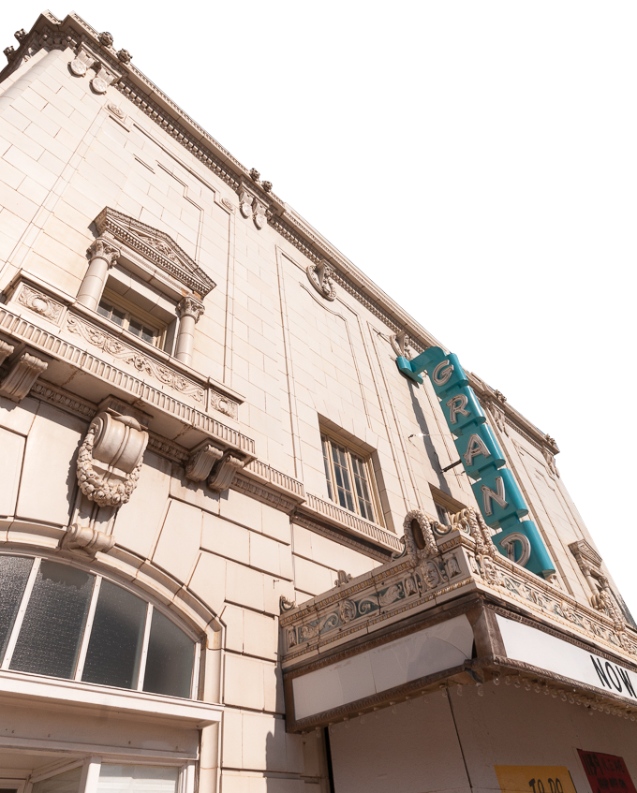
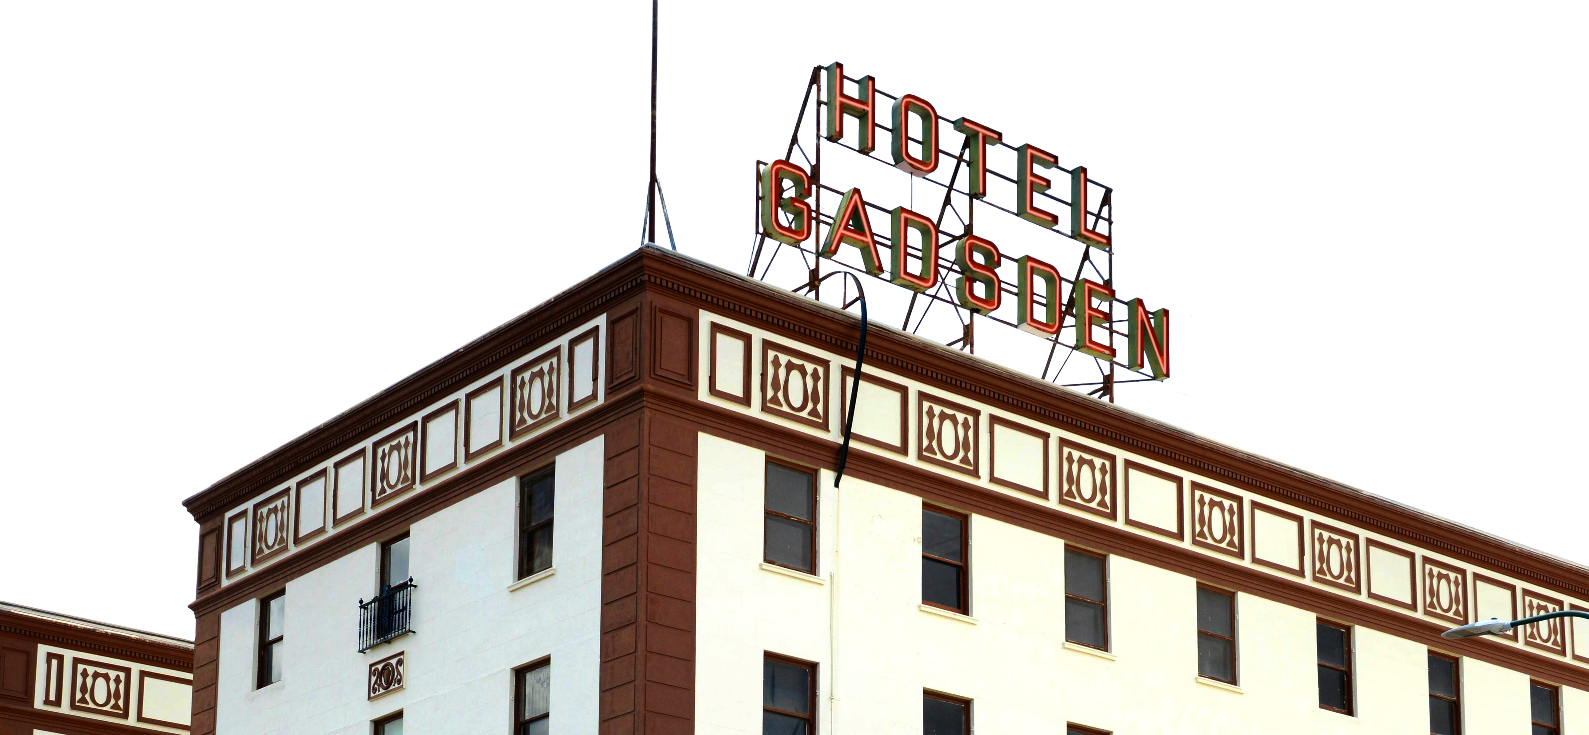
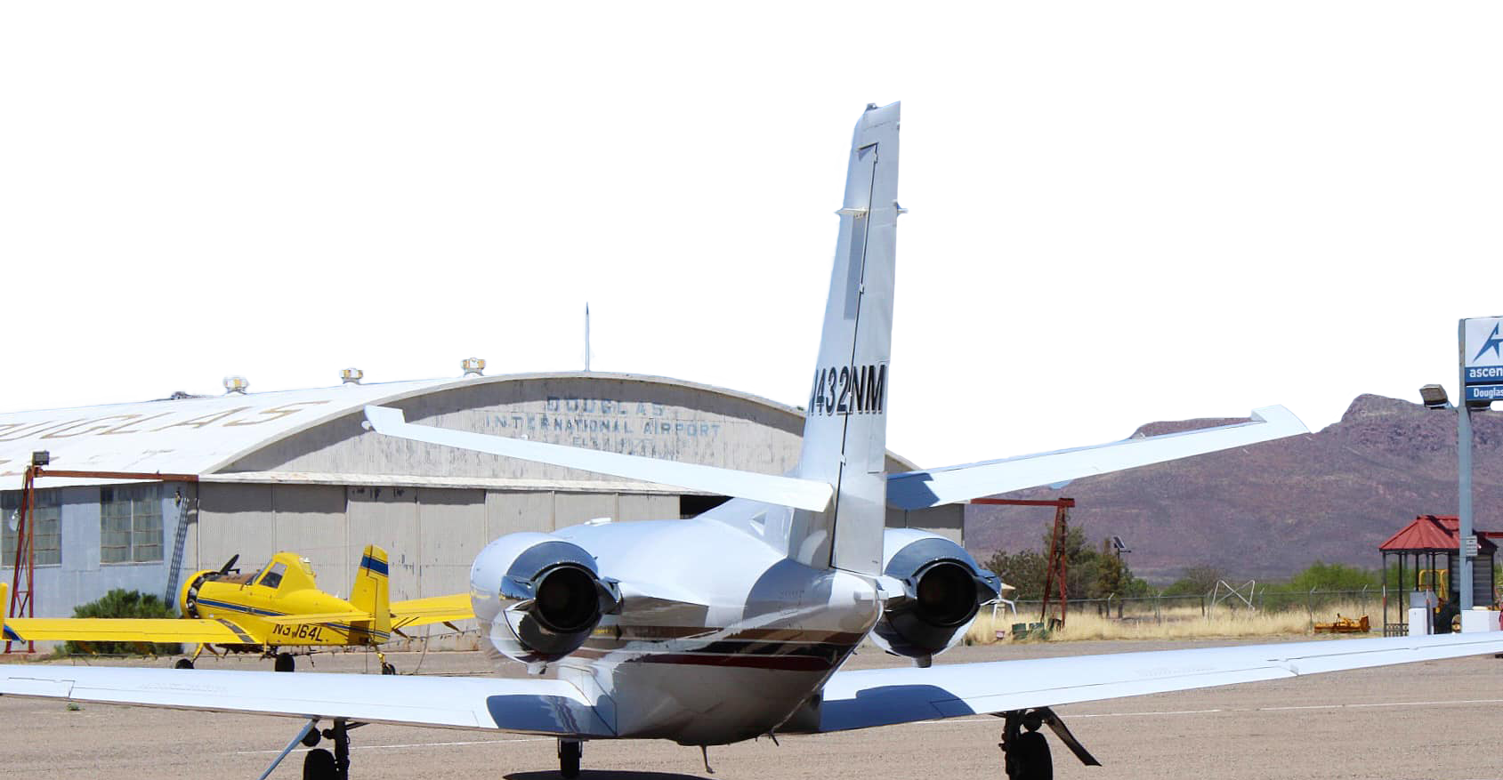

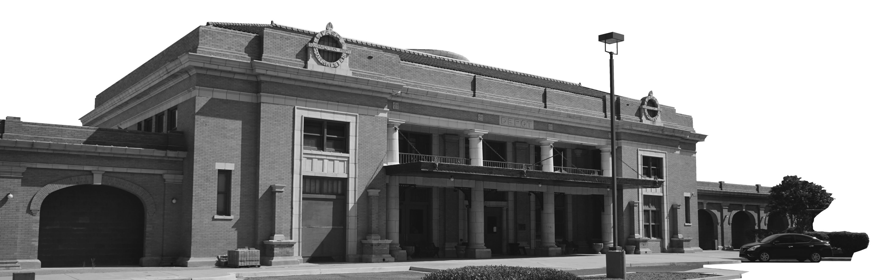

Sales Tax Analysis Presentation to Mayor and Council
May 1, 2024

Slide 2
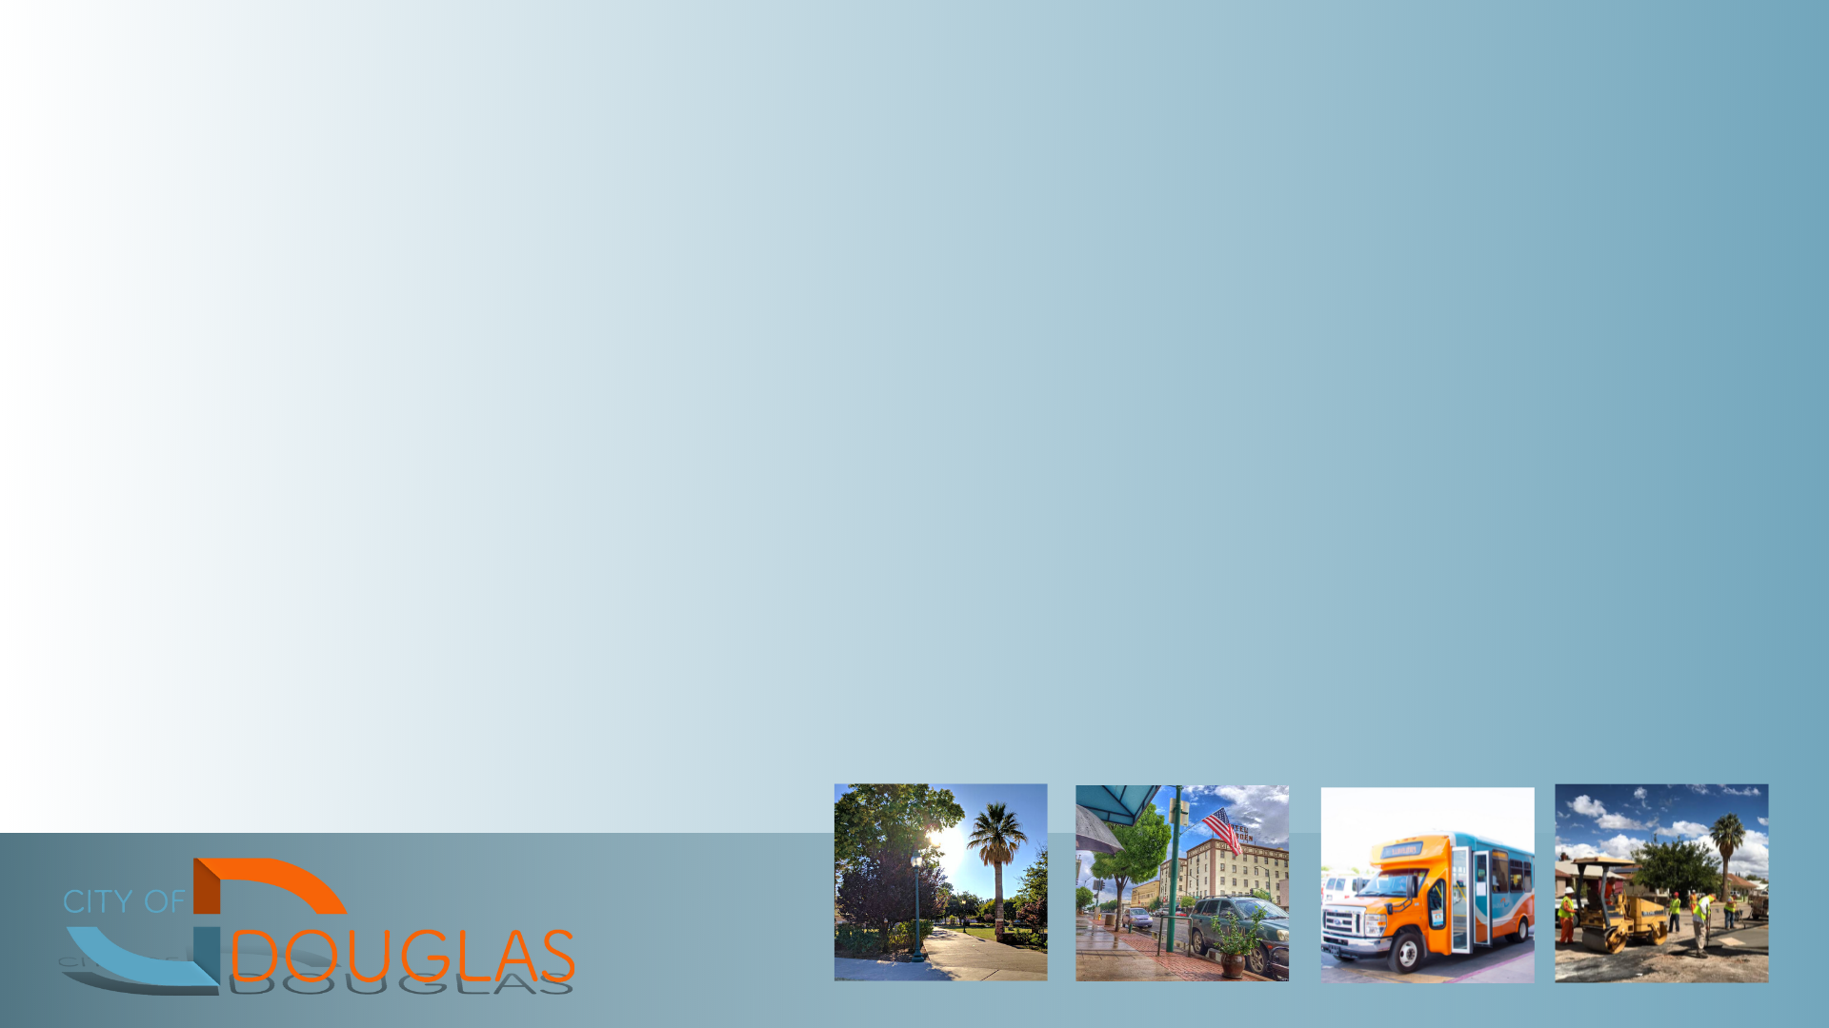
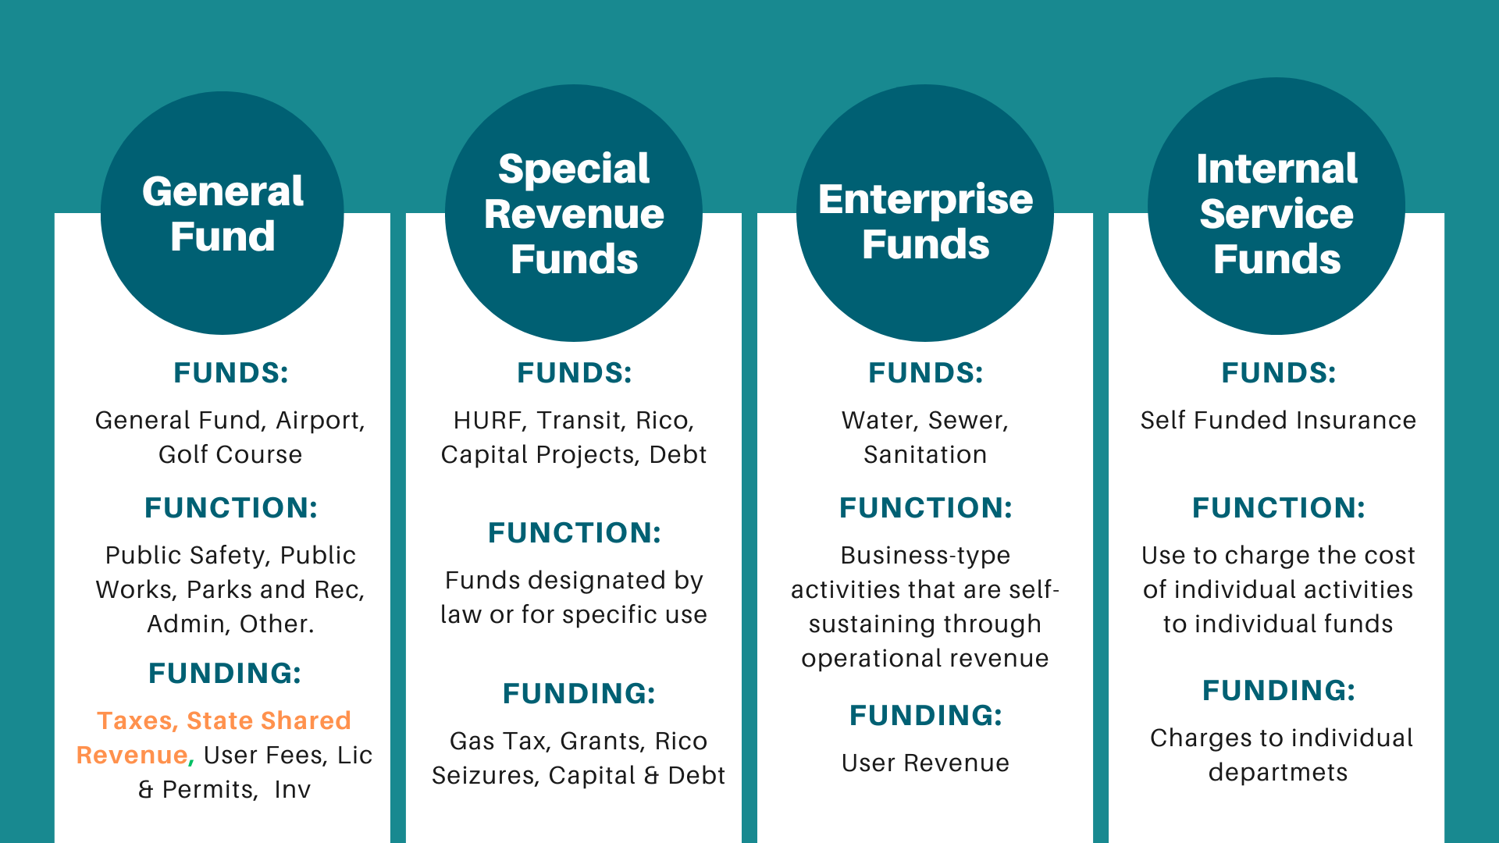
City Funds

Slide 3
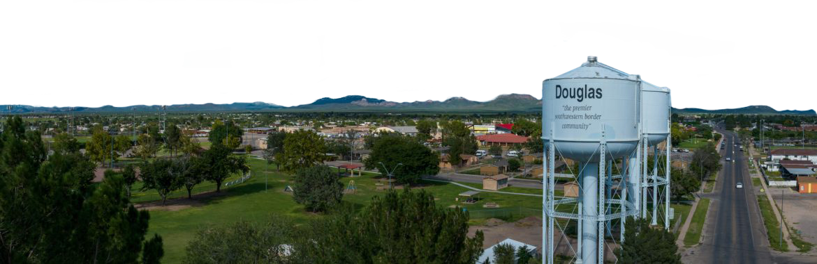

Purpose
The purpose of this presentation is to furnish the Mayor and Council with a comprehensive analysis of the City’s Sales Tax revenue, both preceding and following the one-cent increase implemented in late 2019. Additionally, it seeks to provide recommendations for sustaining growth while exploring avenues to alleviate the tax burden on the residents of Douglas.

Slide 4

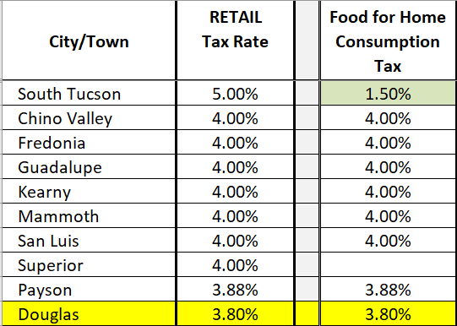
Where do we rank in Arizona?
According to the Arizona League of Cities and Towns
  #10 out of 92 in Retail (3.80%) and Food for Home Consumption (3.80%)
  Douglas was #2 at the time we raised the local sales tax in 2019

Slide 5
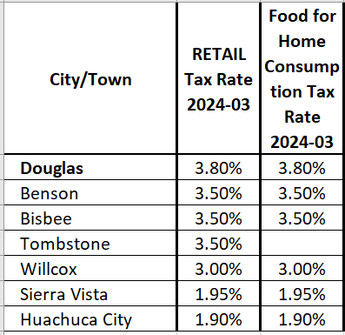
Where do we rank in Cochise County?
According to the Arizona League of Cities and Towns
  Douglas highest, however, the average is 3% and 3.5% excluding Sierra Vista and Huachuca City
  Tombstone increased their sales tax by 1 cent in 2013 and Benson & Bisbee in 2015

Slide 6
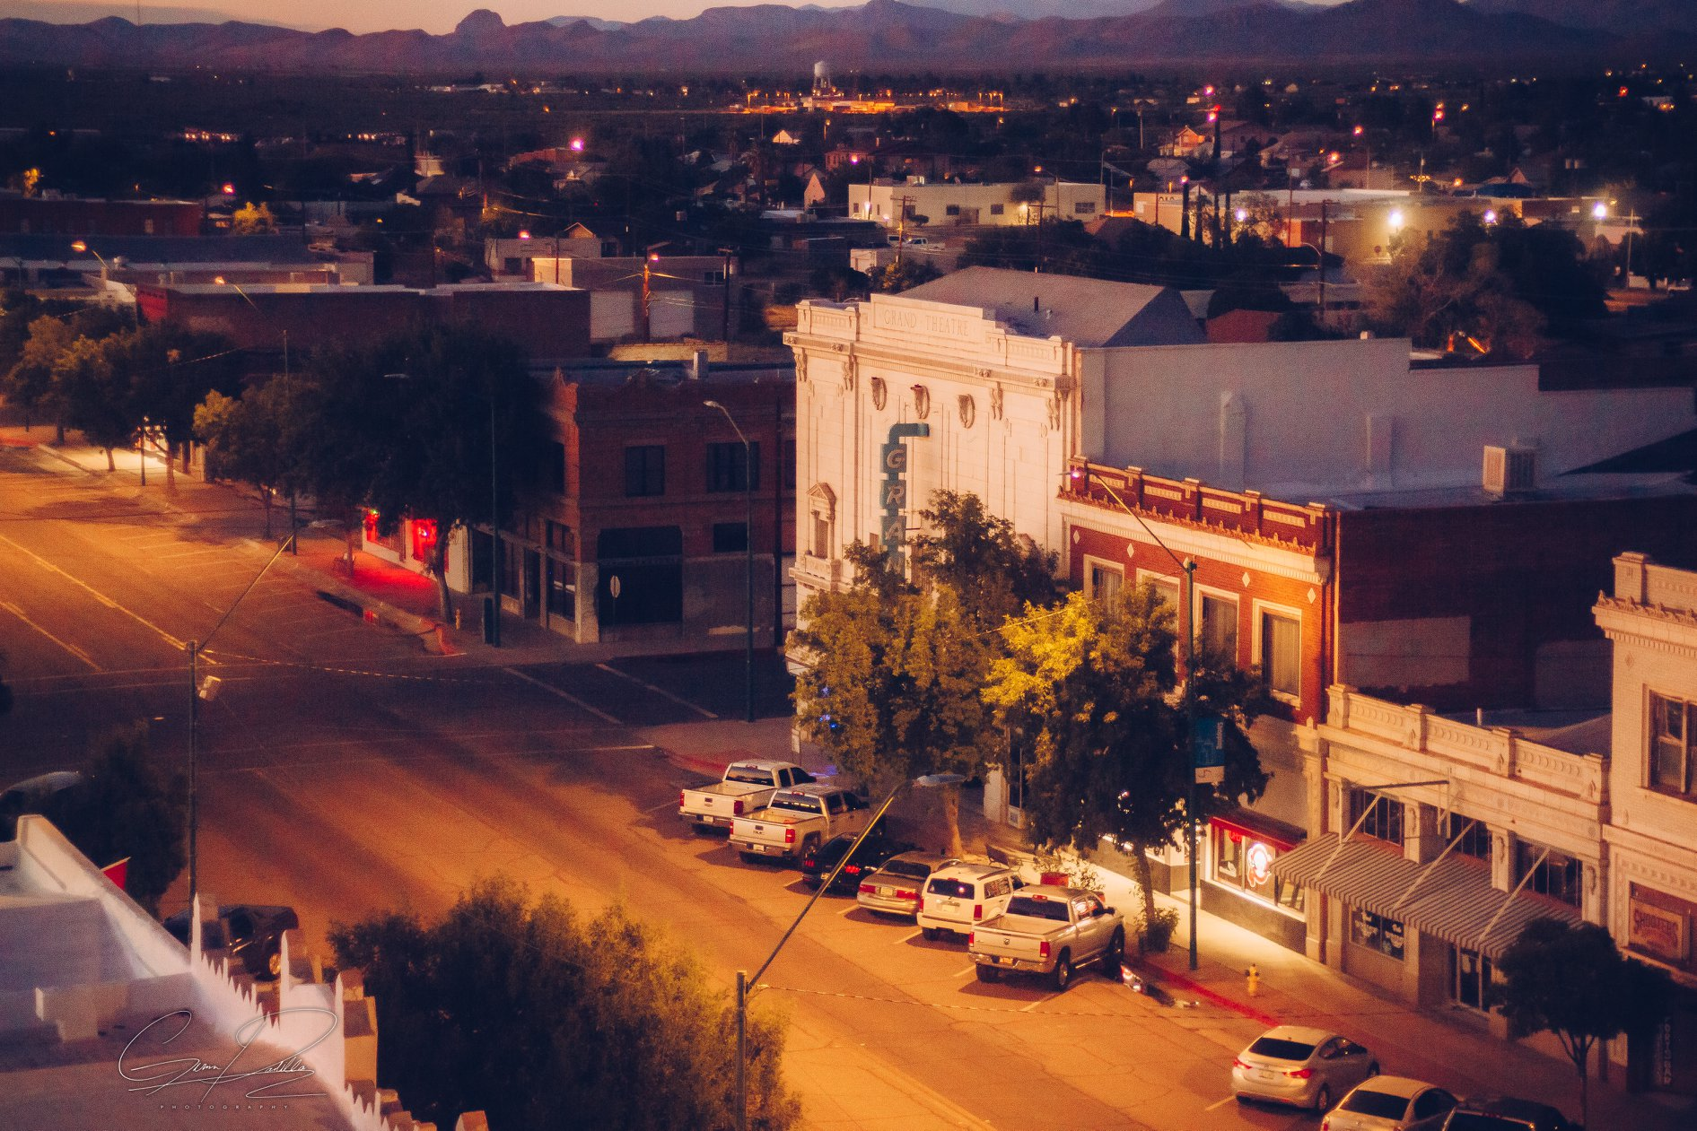
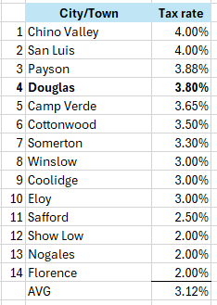
Where do we rank among similar sized Cities and Towns?

Slide 7
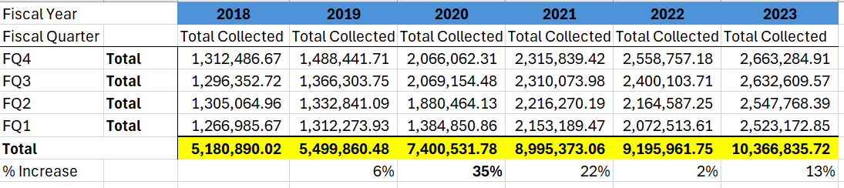
Sales Tax performance 2018-2023

Slide 8
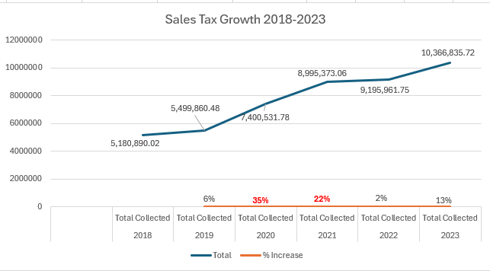
Sales Tax Growth
* 1 cent sales tax increase took effect FY 2020 (October 2019)

Slide 9
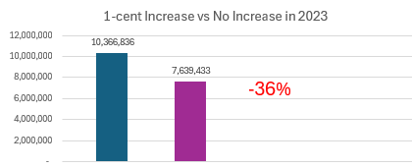
What if the 2019 sales tax increase did not happen?
In 2023
  We would have collected $1.2M less in retail, which represents 44% of our sales tax collected
  Overall, we would have collected 36% less in total sales tax collected from $10,366,836 to $7,605,657 ($2,761,179 reduction)
  This would have likely resulted in severe cuts to City services and programs

Slide 10
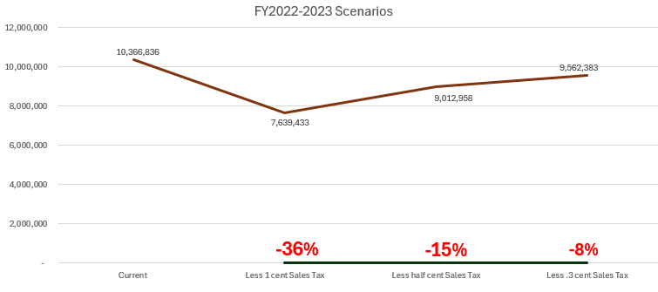
Other scenarios: Half Cent and .3 Reduction

Slide 11
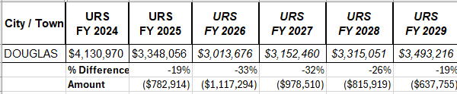
State Shared Revenue
Estimates are provided by the Arizona League of Cities and Towns and based on Joint Legislative Budget Committee (JLBC) Income Tax Collection Estimates
Enactment of flat tax in 2023
Urban Revenue Sharing (URS)

Slide 12
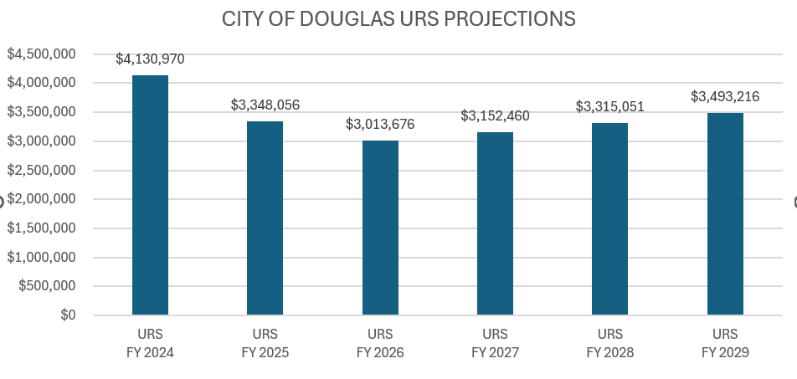
Urban Revenue Sharing (URS) Projections

Slide 13
Visitors vs. Locals
Approximately 52% of our sales tax comes from visitors/nonresidents
Increase in visitors is a way to lessen the impact to residents
  Higher hotel/motel tax
  Higher restaurant/bar sales tax
  However, dangerous and subject to fluctuation. Important to have a steady and growing home base
Inflation – increase in prices increase sales taxes, however, costs to provide City services continue to grow rapidly

Slide 14
Future Considerations
Residential Rental Sales Tax going away beginning January 2025
  $120,000 annual fiscal impact to the City
State legislature has consistently received bills to reduce taxes, by limiting the Model City Tax Code
  Food for Home Consumption
  Construction Contracting
  Online sales tax

Slide 15
Tax Philosophy
Diversified: A Tax Code that has a diversified base is more resilient by providing revenue from a wide range of activities making it less susceptible to drastic revenue impacts
More Equitable: It affects the larger population, which is better than only targeting a small segment of the population
More tax base allows a better opportunity to keep taxes lower
Preparing the City for Growth
  Although currently not growing, the City expects growth in the next 5-10 years
  Growth provides the opportunity to add tax base that can present opportunities for a laddered tax reduction

Slide 16
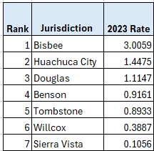
Tax Philosophy
Property Tax
7% reduction in property taxes since 2016 in tax levy rate
Able to keep revenue levels consistent even experiencing revenue increases due to
  1) new construction
  2) increase in property assessed values.
Property taxes can be a vehicle for stable revenue, but the capabilities in AZ are limited

Slide 17
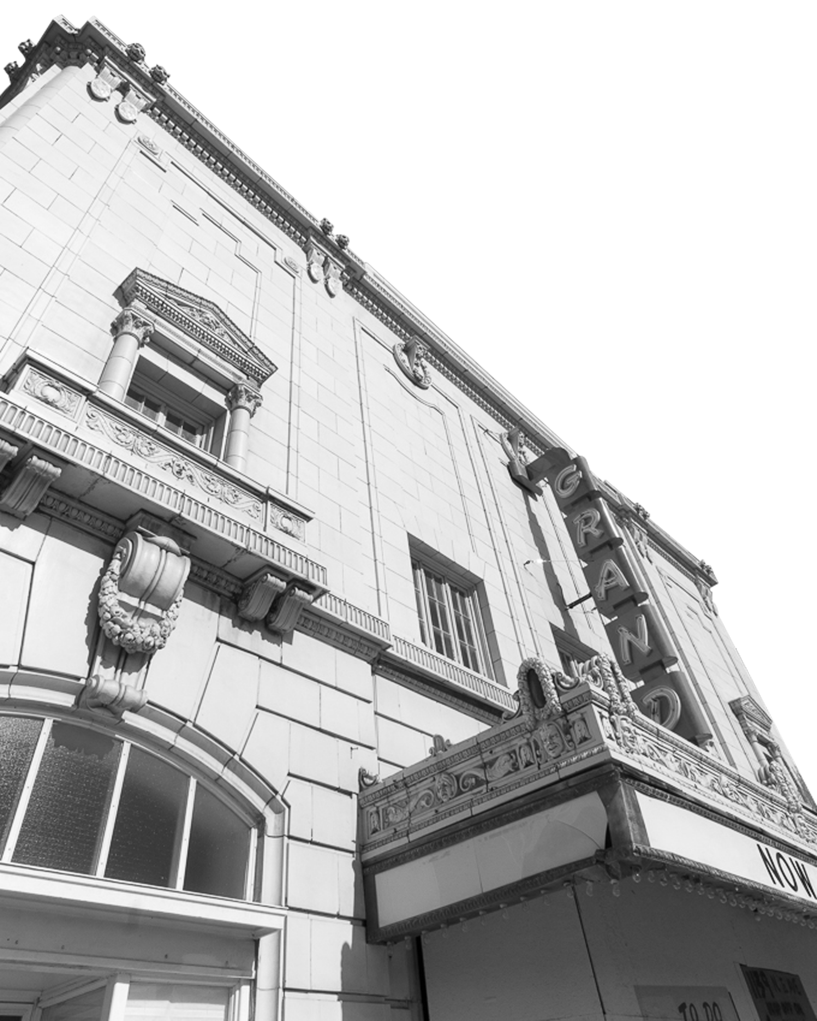
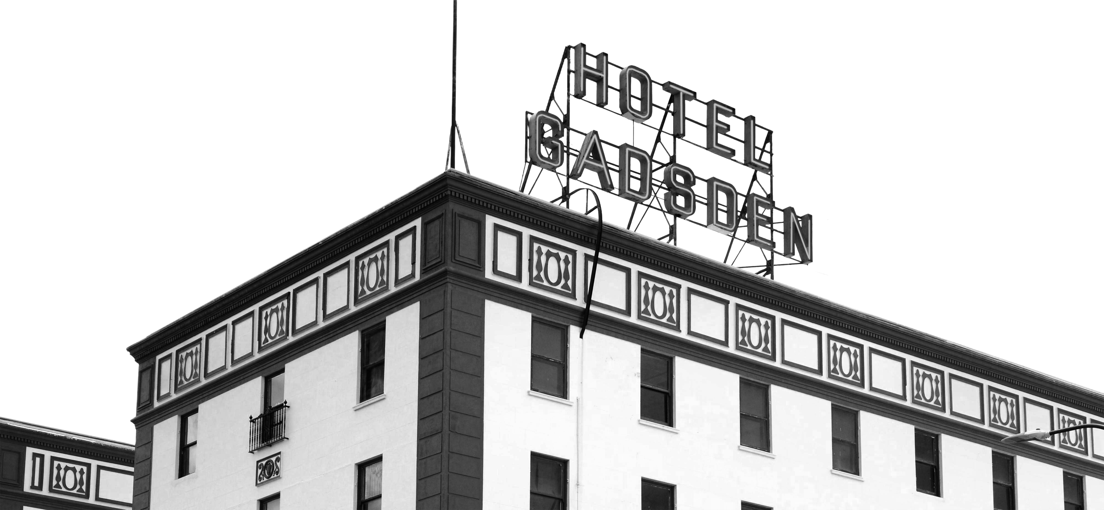
Staff Recommendations
Keep the same sales tax rates until growth is achieved through new Port of Entry and other economic activities
Mitigate the upcoming state shared revenue decreases ($700,000 this year)
As growth comes look at most impactful sales tax categorical reductions with the greatest and most equitable impact (e.g. food for home consumption)
Continue to decrease property tax rates in accordance with growth
Continue with a Diverse Tax Code
  Most equitable tax distribution
  Presents growth potential in different areas for revenue growth
  Local control is always at risk by the State threatening reducing the cities’ ability to raise revenue through sales tax

Slide 18
Other strategies
Phased Reductions: Implement a gradual reduction plan over a set period, dividing the decrease into manageable increments to minimize sudden impacts on revenue streams.
Tourism Promotion: Invest in tourism initiatives to stimulate local economies and increase visitor spending, which can contribute to sales tax revenue growth without raising rates
Long-Term Planning: Develop a comprehensive long-term financial plan that incorporates gradual tax reduction goals while ensuring the sustainability of essential public services
Monitoring and Adjustment: Continuously monitor economic indicators and revenue trends to assess the impact of tax reductions and adjust as needed to maintain fiscal stability.
Sustainability: Continue to find efficiencies toward leaner processes, which can be reflected in long-term savings and more effective services

